Slide 1



PROGRAMMING FUNDAMENTALS IN C
Matrix multiplication and Functions

Slide 2
Objectives
Matrix multiplication
Functions

Slide 3
Content
Matrix Multiplication
Functions
Functions Call Stack and Stack Frames
Exercises
Matrix Multiplication
Functions
The C String Library
Exercises

Slide 4


2X2 Matrix Multiplication
To multiply a matrix by another matrix, do dot product of rows and columns.
The columns of first matrix MUST BE EQUAL TO the rows of the other matrix
$$A=\left[\begin{matrix}1 & 2 & 3 \\ 4 & 5 & 6\end{matrix}\right], B= \left[\begin{matrix}1 & 1 & 1 \\ 1 & 1 & 1 \\ 1 & 1 & 1\end{matrix}\right]$$
A is 2X3
B is 3X3
$$A=\left[\begin{matrix}1 & 2 \\ 3 & 4\end{matrix}\right], B= \left[\begin{matrix}1 & 1 & 1 \\ 1 & 1 & 1 \\ 1 & 1 & 1\end{matrix}\right]$$
A is 2X2
B is 3X3

Slide 5
Matrix Multiplication
To multiply a matrix by another matrix, do dot product of rows and columns.
8
10
11 12
1 2 3
4 5 6
58 64

Slide 6
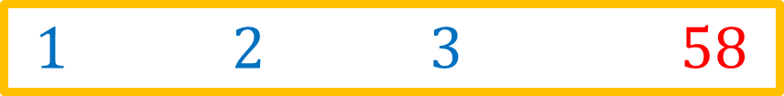
Matrix Multiplication
To multiply a matrix by another matrix, do dot product of rows and columns.
8
10
11 12
1 2 3
4 5 6
58 64
$$1∗7+2∗9+3 ∗11=58$$

Slide 7
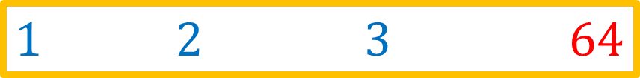
Matrix Multiplication
To multiply a matrix by another matrix, do dot product of rows and columns.
8
10
11 12
1 2 3
4 5 6
58 64
$$1∗8+2∗10+3 ∗12=64$$

Slide 8
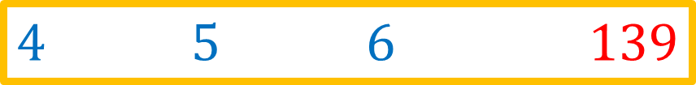
Matrix Multiplication
To multiply a matrix by another matrix, do dot product of rows and columns.
8
10
11 12
1 2 3
4 5 6
58 64 139 222
$$4∗7+5∗9+6 ∗11=139$$

Slide 9
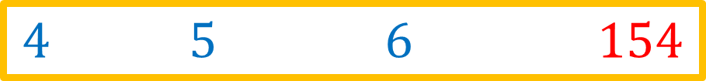
Matrix Multiplication
To multiply a matrix by another matrix, do dot product of rows and columns.
8
10
11 12
1 2 3
4 5 6
58 64 139 154
$$4∗8+5∗10+6 ∗12=154$$

Slide 10
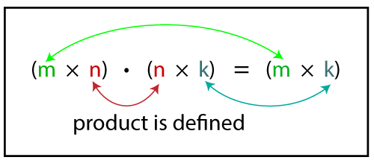

Matrix Multiplication
Note that, given matrix $A(m×n)$ and matrix $B(n×k)$, the result matrix is $C(m×k)$

Slide 11
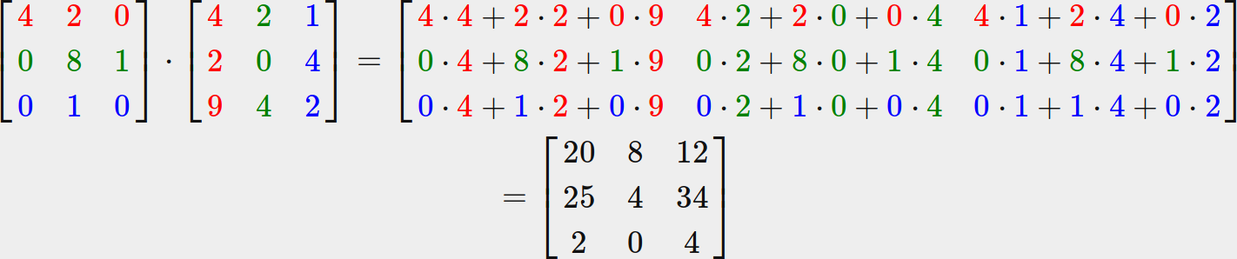
Matrix Multiplication

Slide 12
Matrix Multiplication
Algorithm
We loop over the rows of the first matrix
Then we loop over the columns of the second matrix
Then we loop over each element of both the row and column vector to compute the dot product

Slide 13
Matrix Multiplication
Algorithm
Assume dimension of A is (m x n), dimension of B is (p x q)
IF: n is not same as p,
then exit
ELSE:
define C matrix as (m x q)
FOR: i = 0 to m - 1, do {
FOR: j = 0 to q – 1, do {
FOR: k = 0 to p, do {
C[i, j] = C[i, j] + (A[i, k] * A[k, j])
}
}
}

Slide 14
Content
Matrix Multiplication
Functions
The C String Library
Exercises

Slide 15
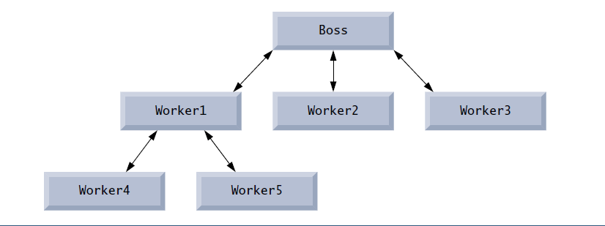
Functions
Functions are used to modularize programs.
Functions are invoked by a function call, which specifies the function name and provides information (as arguments) that the function needs to perform its task.

Slide 16
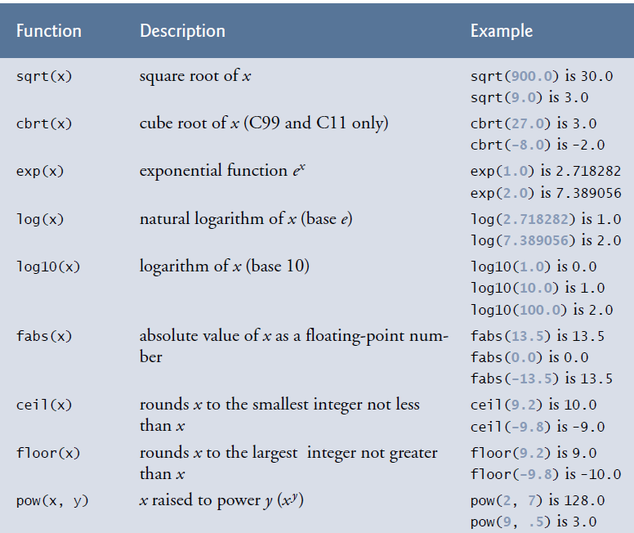

Functions
Commonly used math library functions in $math.h$ file

Slide 17

Functions
To define your own function
Define function prototype before $main()$ function
Define the function with its body after $main()$ function
Function body
Function prototype (function header)
Data_type function_name(parameters)
{
…
}
Data_type function_name(parameters);

Slide 18

Functions
Datatypes can be:
$void$ if the function will not return a value
$int, float, double, char, …$ , if the function will return a value of a certain datatype.
Function body
Function prototype (function header)
Data_type function_name(parameters)
{
…
}
Data_type function_name(parameters);

Slide 19
Functions
Function names follow the same rules as variable names
Function body
Function prototype (function header)
Data_type function_name(parameters)
{
…
}
Data_type function_name(parameters);

Slide 20
Functions
Parameters are the data we pass to function to operate with.
We can pass more than one parameter, each is separated by “,”
All variables defined in function definitions are local variables—they can be accessed only in the function in which they’re defined.
Function body
Function prototype (function header)
Data_type function_name(parameters)
{
…
}
Data_type function_name(parameters);

Slide 21
Functions
Example: a function to compute the square of a number
int square(int y); // function prototype
int main() {
// loop 10 times and calculate and output square of x each time
for (int x = 1; x <= 10; ++x) {
printf("%d ", square(x)); // function call
}
puts("");
}
// square function definition returns the square of its parameter
int square(int y) {// y is a copy of the argument to the function
return y * y; // returns the square of y as an int
}

Slide 22
Functions
Example: a function to find a maximum between three numbers
int max(int n1, int n2, int n3);
int main() {
printf("The max is %d \n", max(5, 10, 7));
}
int max(int n1, int n2, int n3) {
if (n1 >= n2 && n1 >= n3) {
return n1;
}
else if (n2 > n1 && n2 > n3) {
return n2;
}
else{
return n3;
}
}

Slide 23
Functions
Example: find a maximum between three numbers (variation)
void max(int n1, int n2, int n3);
int main() {
max(1, 7, 2);
}
void max(int n1, int n2, int n3) {
int max;
if (n1 >= n2 && n1 >= n3) {
max = n1;
}
else if (n2 > n1 && n2 > n3) {
max = n2;
}
else{
max = n3;
}
printf("The max is %d \n", max);
}

Slide 24
Content
Matrix Multiplication
Functions
The C String Library
Exercises

Slide 25

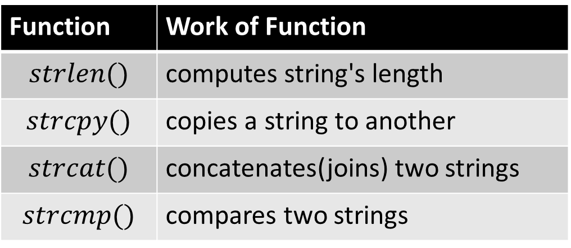
The C String Library
String functions are provided in an ANSI standard string library
Access this through the include file:
$\#include <string.h>$
Includes functions such as:
Computing length of string
Copying strings
Concatenating strings
Function | Work of Function
$$strlen()$$ | computes string's length
$$strcpy()$$ | copies a string to another
$$strcat()$$ | concatenates(joins) two strings
$$strcmp()$$ | compares two strings

Slide 26

The C String Library
$strlen()$ returns the length of a NULL terminated character string:
size_t strlen(char *str);

Slide 27

The C String Library
$strcpy()$ copies a string to another
A copy of $source$ is made at $destination$
source should be NULL terminated
destination should have enough room (its length should be at least the size of source)
The return value points at the destination
char *strcpy(char *destination, char *source);

Slide 28

The C String Library
$strcat()$ concatenates two stings:
Appends a copy of $str2$ to the end of $str1$
A pointer equal to $str1$ is returned
Ensure that str 1 has sufficient space for the concatenated string!
char* strcat(char * str1, char * str2);

Slide 29

The C String Library
$strcmp()$ compares strings for equality or inequality
The function returns:
0, if $str1$ is the same as $str1$
$>0$, if $str1$ is greater than $str2$ in terms of ASCII characters
$<0$, if $str1$ is less than $str2$ in terms of ASCII characters
int strcmp(char *str1, char *str2);

Slide 30
QUIZ
Can we return an array from a function?
How we can return an array from a function

Slide 31
Content
Matrix Multiplication
Functions
The C String Library
Exercises

Slide 32
Exercise 1
Write a function to get your name as a parameter, and prints welcome <name>

Slide 33
Exercise 1
Write a function to get your name as a parameter, and prints welcome <name>
void welcome(char name[]);
int main() {
welcome("Omar");
}
void welcome(char name[]) {
printf("Welcome %s\n", name);
}

Slide 34
Exercise 2
Write a function to compute the sum of float array. The array has 5 elements read from the user.

Slide 35
Exercise 2
Write a function to compute the sum of float array. The array has 5 elements read from the user.
#define SIZE 5
float sum(float nums[], int size);
int main() {
float nums[SIZE];
int i;
for (i = 0; i < SIZE; i++) {
float x;
scanf("%f", &x);
nums[i] = x;
}
printf("The sum of the array is %.3f\n", sum(nums, SIZE));
}
float sum(float nums[], int size) {
float sum = 0;
int i;
for ( i = 0; i < size; i++) {
sum += nums[i];
}
return sum;
}

Slide 36

Exercise 3
Write a function to compute the distance between two points, $p_{1}\left(x_{1},y_{1}\right), p_{2}(x_{2},y_{2})$
The distance is computed using: $\sqrt{{\left(x_{2}−x_{1}\right)}^{2}+{\left(y_{2}−y_{1}\right)}^{2}}$

Slide 37
Exercise 3
Write a function to compute the distance between two points, $p_{1}\left(x_{1},y_{1}\right), p_{2}(x_{2},y_{2})$
The distance is computed using: $\sqrt{{\left(x_{2}−x_{1}\right)}^{2}+{\left(y_{2}−y_{1}\right)}^{2}}$
//solution 1
float distance(float x1, float y1, float x2, float y2) { // you must #include<math.h>
float x_diff = x1 - x2;
float x_diff_sq = pow(x_diff, 2);
float y_diff = y1 - y2;
float y_diff_sq = pow(y_diff, 2);
float distance = sqrt(x_diff_sq + y_diff_sq);
return distance;
}

Slide 38
Exercise 3
Write a function to compute the distance between two points, $p_{1}\left(x_{1},y_{1}\right), p_{2}(x_{2},y_{2})$
The distance is computed using: $\sqrt{{\left(x_{2}−x_{1}\right)}^{2}+{\left(y_{2}−y_{1}\right)}^{2}}$
//solution 2
float distance(float x1, float y1, float x2, float y2) {
float distance = sqrt(pow((x1 - x2), 2) + pow((y1 - y2), 2));
return distance;
}
//solution 3
float distance(float x1, float y1, float x2, float y2) {
return sqrt(pow((x1 - x2), 2) + pow((y1 - y2), 2));
}

Slide 39
Exercise 4
Write a function to determine if an integer is even or odd

Slide 40
Exercise 4
Write a function to determine if an integer is even or odd
int main() {//solution 2
int x = isEven(5);
if (x == 1) {
puts("The number is even");
}
else{
puts("The number is odd");
}
}
int isEven(int num) {
if (num % 2 == 0)
return 1;
else
return 0;
}
//solution 1
int main() {
isEven(5);
}
void isEven(int num) {
if (num % 2 == 0)
printf("The num is even\n");
else
printf("The num is odd\n");
}

Slide 41
Exercise 4
Write a function to determine if an integer is even or odd
int main() {//solution 3
int x = isEven(5);
if (x) {
puts("The number is even");
}
else{
puts("The number is odd");
}
}
int isEven(int num) {
if (num % 2 == 0)
return 1;
else
return 0;
}
int main() {//solution 4
int x = isEven(5);
if (x==true) { // or if(x)
puts("The number is even");
}
else{
puts("The number is odd");
}
}
//must #include<stdbool.h>
int isEven(int num) {
if (num % 2 == 0)
return true;
else
return false;
}

Slide 42
Exercise 5
Write a function to check the username and password are valid or not. If they are valid, the program prints “You logged in successfully”, otherwise, the program outputs “Incorrect username or password”. Suppose the default username is “admin” and the password is “adminXY123”

Slide 43
TASK 1
Write a function to compute the multiple two matrices.
Write a function to compute the sum two matrices.

Slide 44
TASK 2
Write a function that takes an integer and returns the sum of its digits. For example, given the number 7631, the function should return 17.

Slide 45
TASK 3
Write a function that takes the time as three integer arguments (for hours, minutes, and seconds) and returns the number of seconds.

Slide 46
TASK 4
Write a function to convert a string characters to uppercase.

